Slide 1
September 2022

Slide 2
CONTENTS
3
ABOUT THE LECTURER
INTRODUCTION TO MANAGEMENT INFORMATION SYSTEM (MIS)
PROBLEM FACING
ASSESSMENT
COURSE OBJECTIVES
COURSE CONTENTS
REFERENCES

Slide 3
ABOUT THE LECTURER
5
Dr. Le Thi Kim Hien (Hien Le) – FIS Alumni (2008 – 2012)
Website: https://h4all.github.io/
Email: hienltk@uel.edu.vn

Slide 4















INTRODUCTION TO MIS MAJOR
7
GENERAL INFORMATION
1
PROGRAM OUTCOMES
2
TRAINING PROGRAM
3
JOB OPPOTURNITIES
4
UNIVERSITY’S INFRASTRUCTURE
5
6
6
BUSINESS COOPERATION

Slide 5
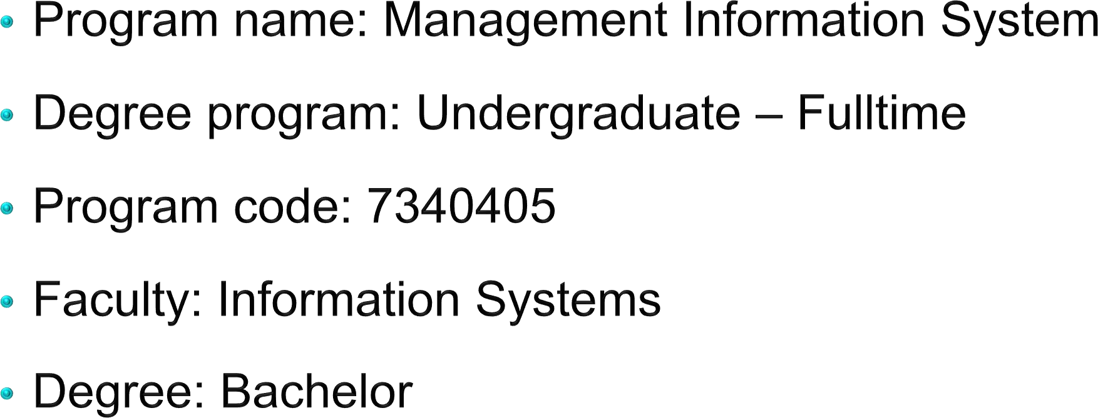
1. General Information
8

Slide 6










2. Program outcomes
9
Have all necessary professional knowledge about information technology applied in business; Mastering business processes and corporate governance
Deeply understand the coordination between technology, management, and human factors in a management information system
Ability to analyze, design, develop, deploy and operate Information
System projects in the fields of economics, management
Capable of detecting, evaluating, selecting, proposing, and consulting solutions based on modern information technology and data
Human resources with good professional ethics

Slide 7
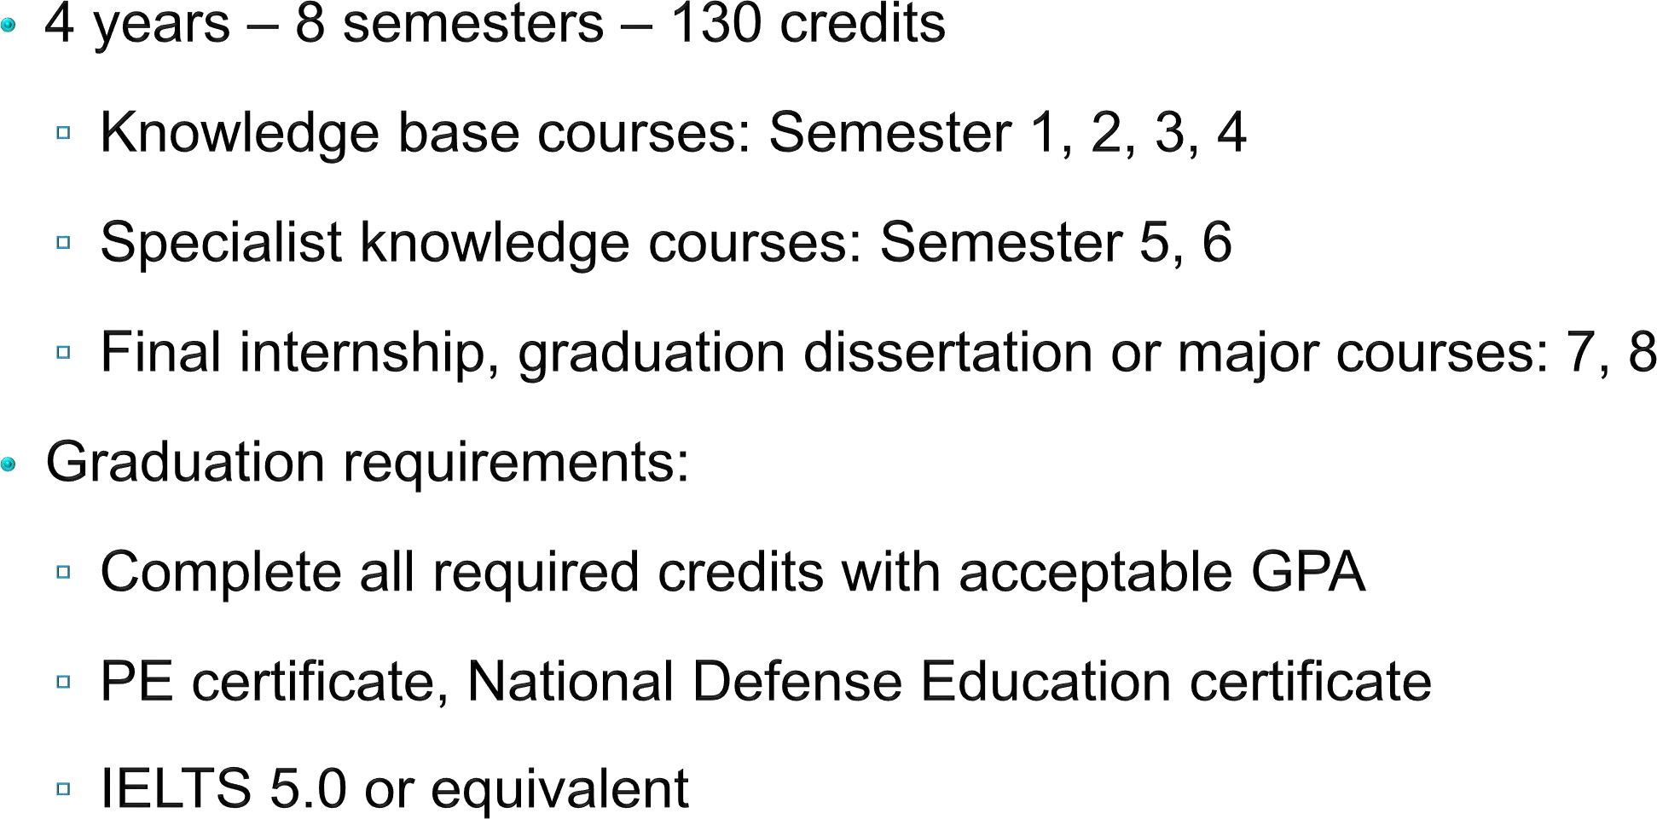
3. Training program
10

Slide 8
















4. Job opportunities
11
Bridge Engineer
IT Consultant, ERP Consultant Business Analyst
System Administrator/ Database Administrator Software Engineer, Tester
JOB
OPPORTUNITIES
CIO, CDO

Slide 9
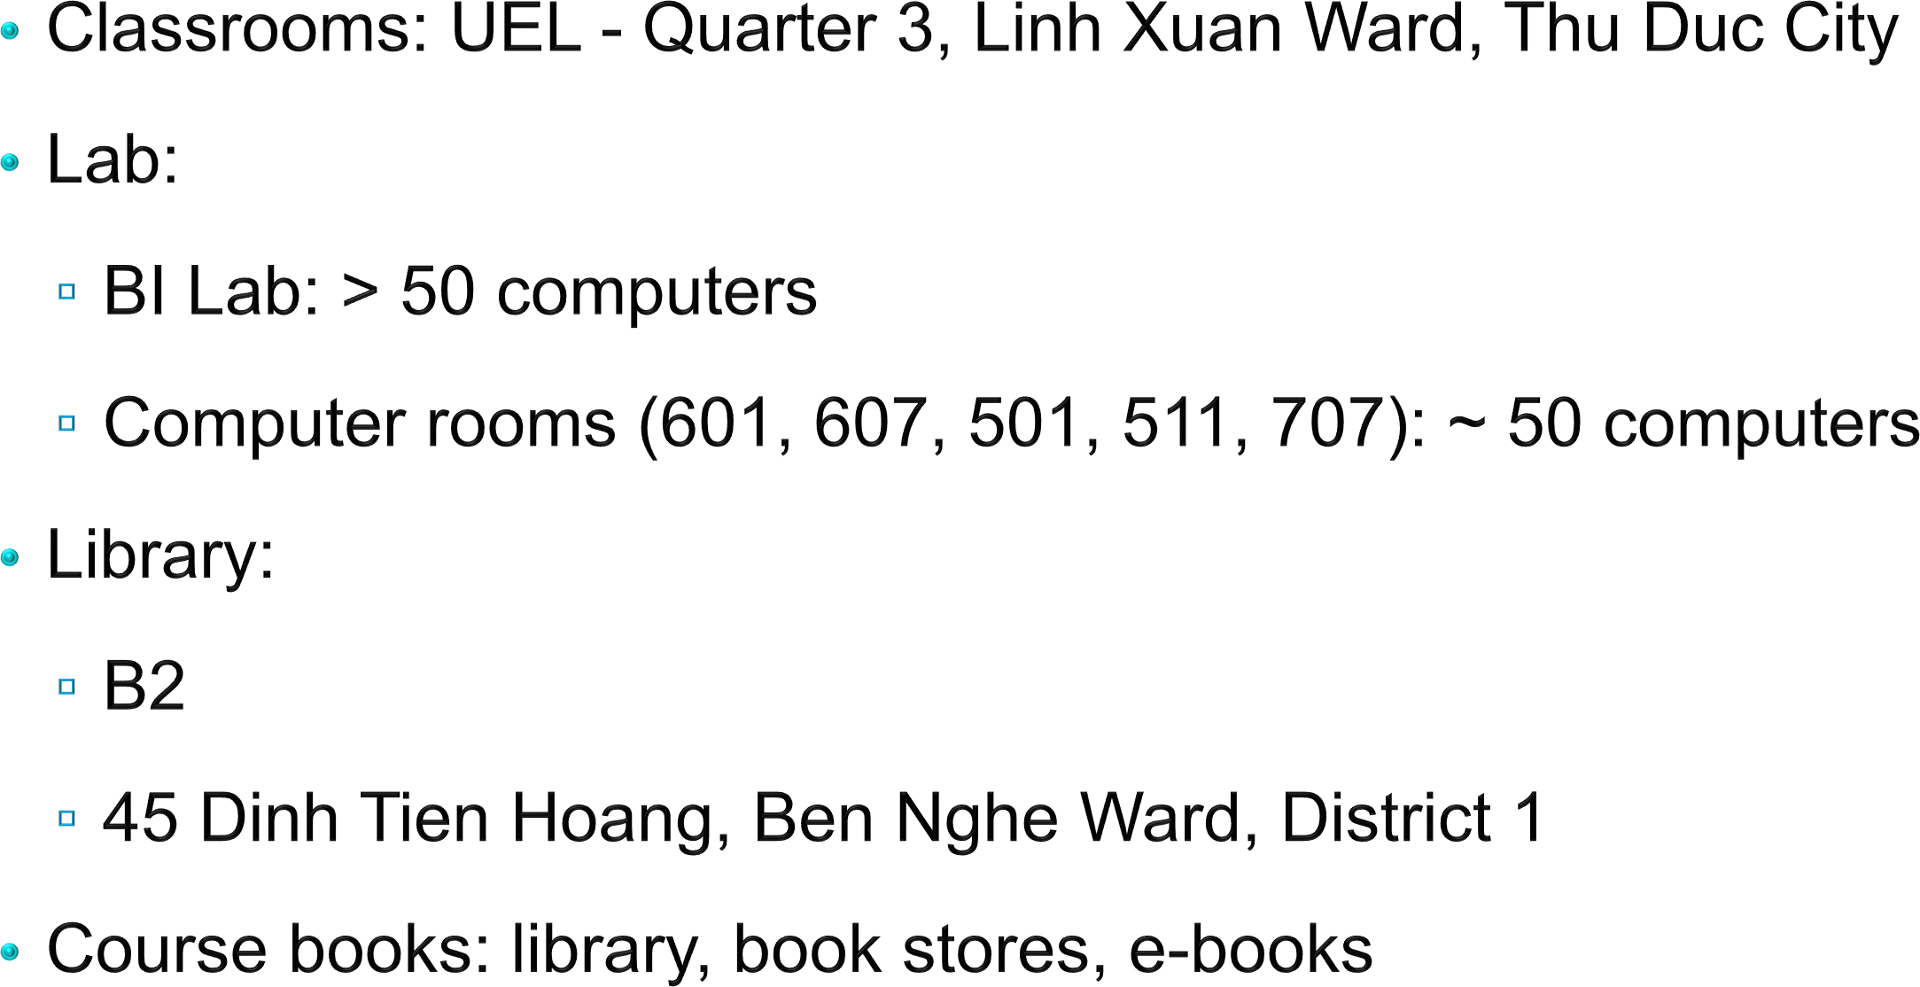
5. Infrastructure
12

Slide 10
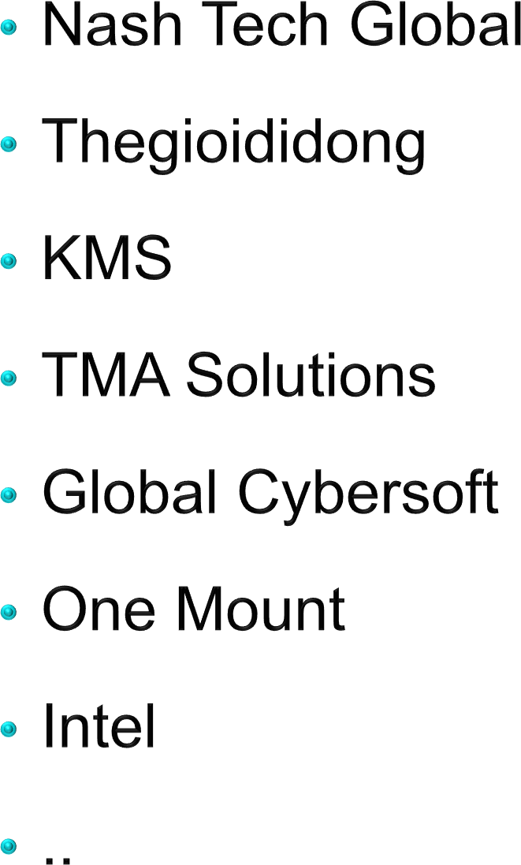
6. Business cooperation
13

Slide 11
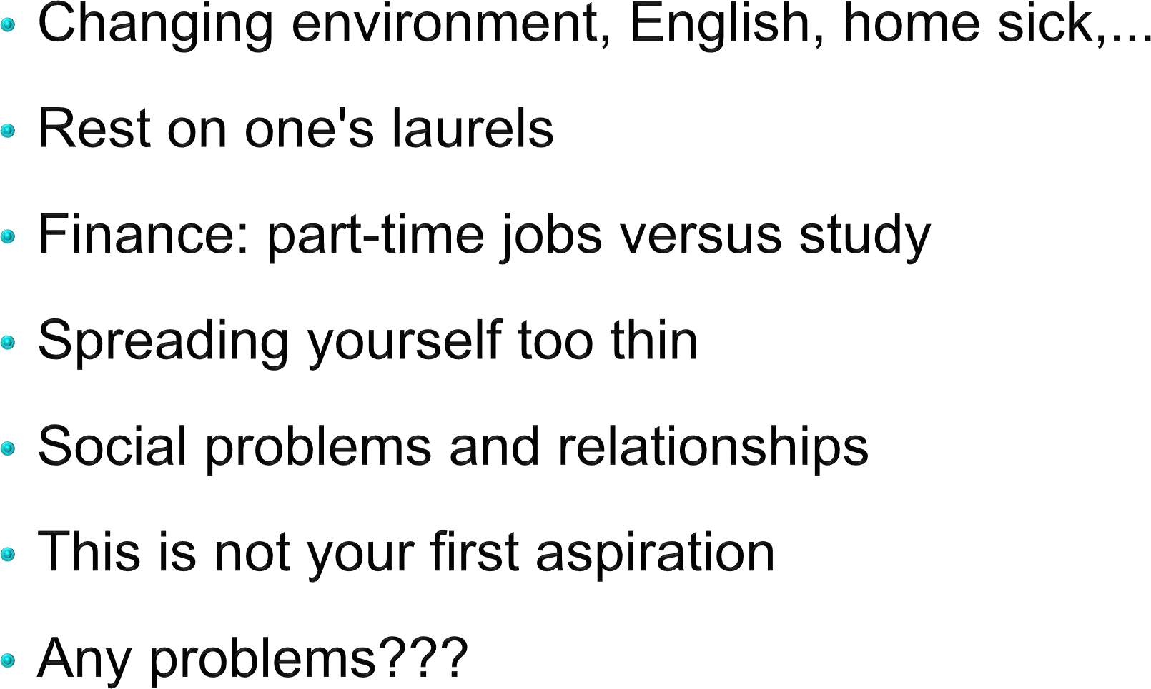
PROBLEM FACING
14

Slide 12
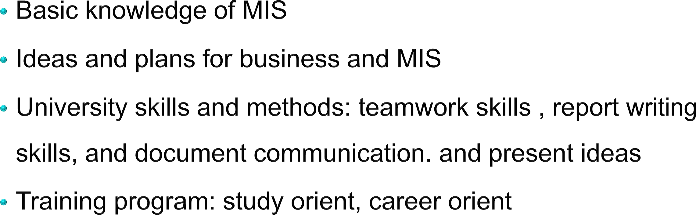
COURSE OBJECTIVES
15

Slide 13
ASSESSMENT
16
On-going: 40%
Individual assignments
Mid-term: 20%
Taking the in-class exam
Final: 40%
Group essay

Slide 14
COURSE CONTENTS
17
Week 1: Overview of MIS
Week 2: Building MIS projects
Week 3: Career path of MIS – Assignment 1
Week 4: The key to be successful at university
Week 5: Soft skills – Assignment 2
Week 6: Mid-term
Week 7: Seminar 1
Week 8: Communication in MIS
Week 9 + 10: Final presentation + Review

Slide 15
COURSE CONTENTS
18
Standard report:
See file Instruction of Standard Report
Standard presentation:
Slide Power point
Presenter: every member
Language: English/Vietnamese
Timing: 10 minutes for presenting and 10 minutes for Q&A

Slide 16
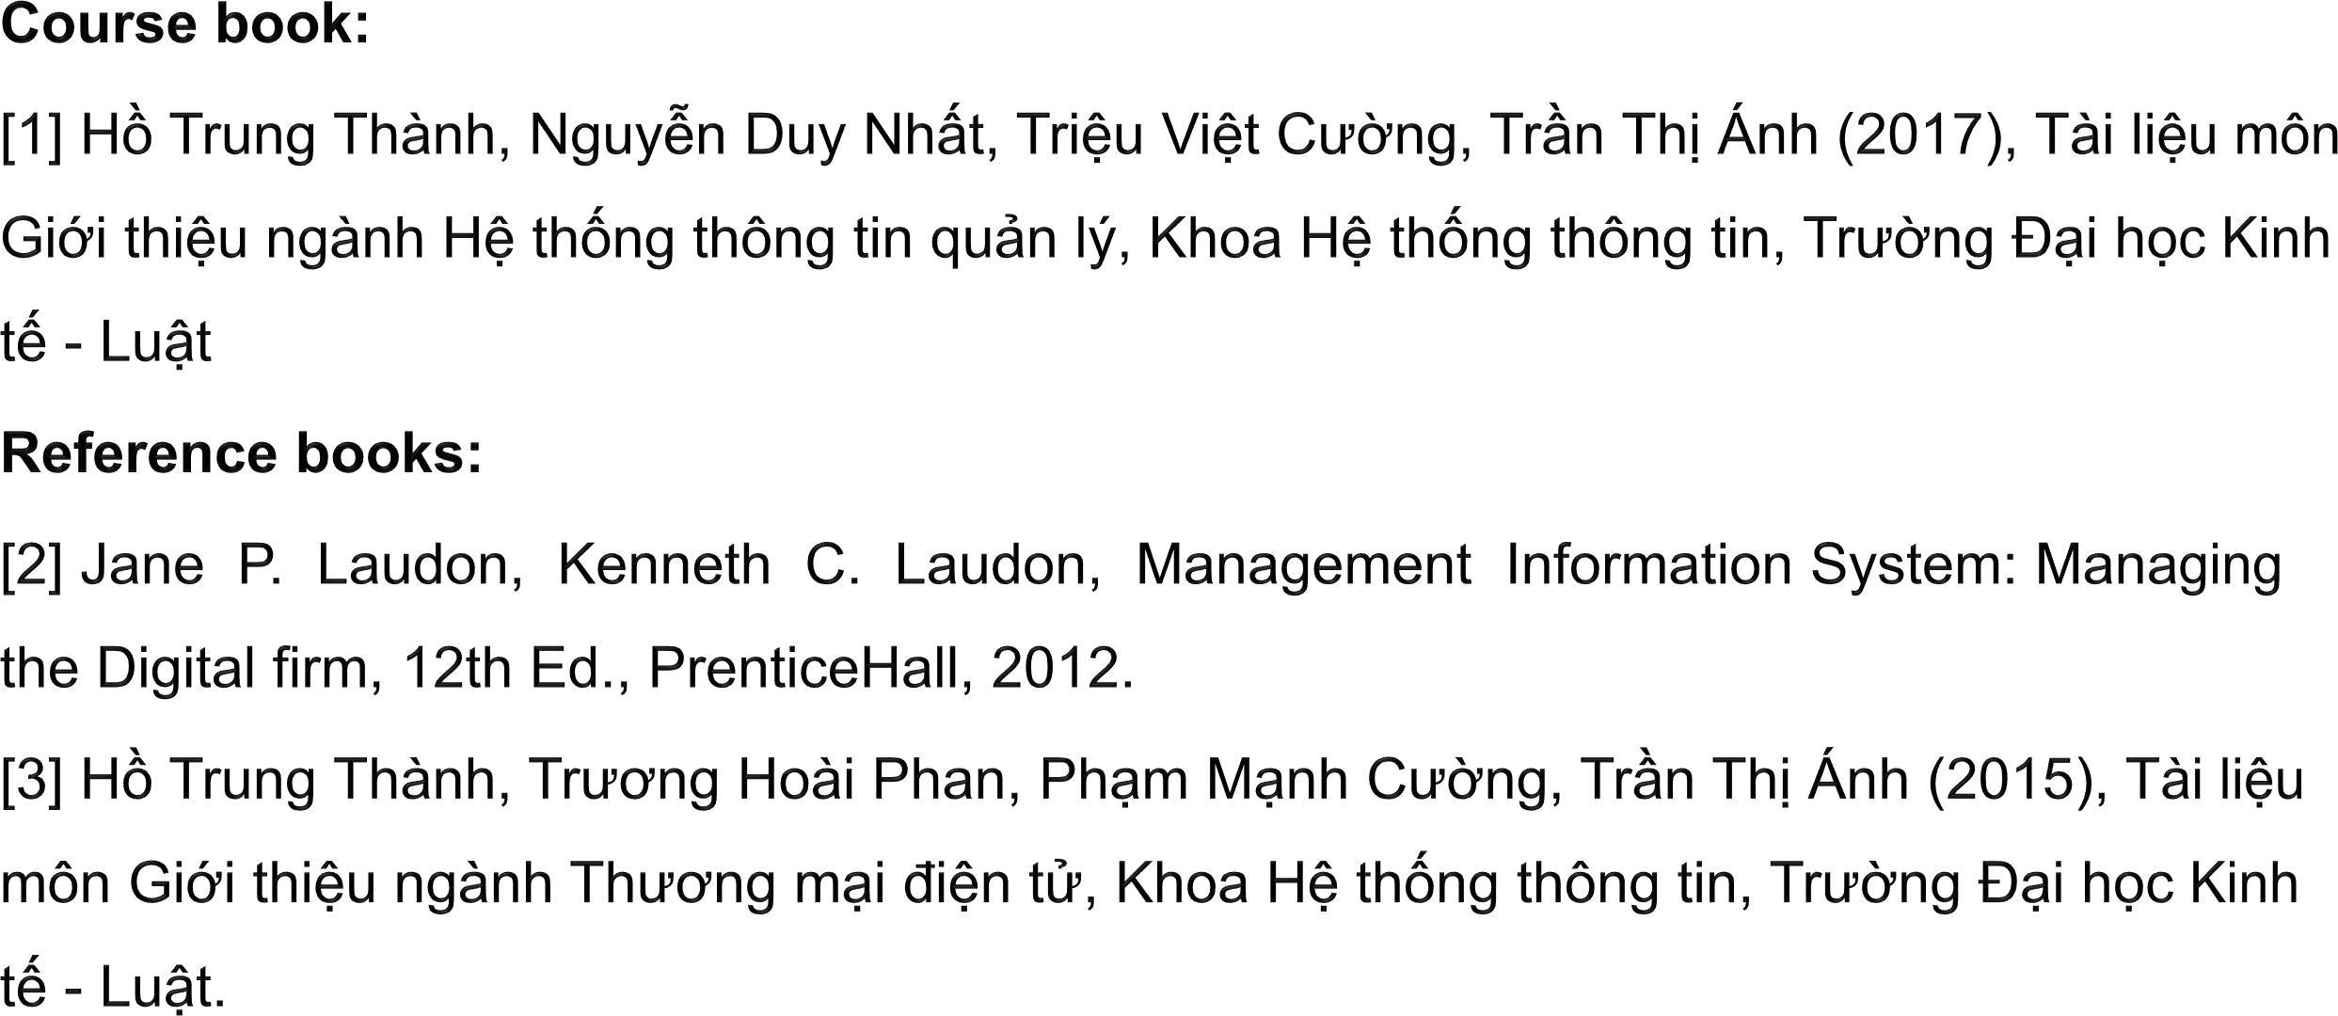
REFERENCES
19

Slide 17
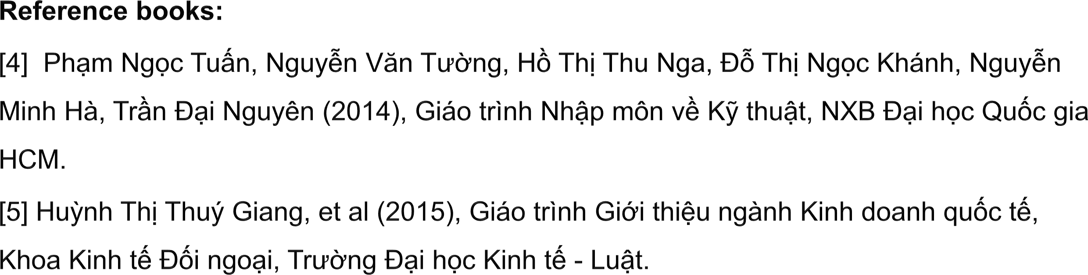
REFERENCES
20

